Slide 1
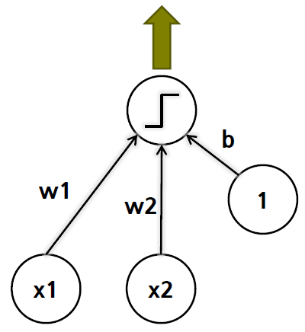

Assignment 1 (TensorFlow)
import tensorflow as tf x_data = [[0.1, 2.3]] X = tf.placeholder(tf.float32, shape=[None, 2]) W = tf.Variable(tf.random_normal([2, 1]), name='weight') b = tf.Variable(tf.random_normal([1]), name='bias') hypothesis = tf.maximum(0.0, tf.sign(tf.matmul(X, W) + b))
with tf.Session() as sess: sess.run(tf.global_variables_initializer()) prediction = sess.run(hypothesis, feed_dict={X: x_data}) print(prediction)
Sigmoid
ReLU
$$x_{3}$$

Slide 2

Assignment 1 (PyTorch)
import torch import torch.nn as nn import numpy as np x_data = np.array([[0.1, 2.3]], dtype=np.float32) x_data = torch.from_numpy(x_data) linear = nn.Linear(2, 1) hypothesis = torch.relu(torch.sign(linear(x_data)))
print(hypothesis)
Sigmoid
ReLU
$$x_{3}$$

Slide 3
Submission
Due to : ~ 9/13(일) 23:59:59
Submission : Online submission on blackboard
Your submission should include (use TensorFlow or PyTorch)
- perceptron.py (3 inputs)
- a brief report about results (step, sigmoid, ReLU)
You must implement the components yourself!
File name : StudentID_Name.zip

